Slide 1
SECURING THE AIR TRAFFIC
BY MZW

Slide 2

DAY 1
Introduction to network protocols
Introduction to wireshark
Command line packet analysis
Network layer protocols
Transport layer protocols
Common upper layer protocols

Slide 3

Introduction to network protocols

Slide 4
NETWORK COMMUNICATION
refers to exchange of data and information between multiple devices, systems, or entities over a network, which can be a local network (LAN) or a wide area network (WAN) like the Internet.
this communication enables devices to share data, resources, and services, allowing users to access remote information, collaborate and perform various tasks.

Slide 5

NETWORK COMMUNICATION
involves the following key components:
Data Transmission
Protocols
Devices
Addresses
Routing
Switching
Firewalls
Bandwidth and Latency
Client-Server Architecture
Peer-to-Peer (P2P) Architecture

Slide 6
Data transmission
Data is sent between devices in the form of packets. These packets contain the actual information being communicated along with metadata like source and destination addresses.

Slide 7
Protocols
Communication over a network follows a set of rules and conventions known as protocols. Protocols define how data should be formatted, transmitted, received, and interpreted. Examples of network protocols include TCP/IP, HTTP, FTP, and SMTP.

Slide 8
DEVICES
Devices participating in network communication include computers, servers, routers, switches, and other networking equipment. Each device has a unique address to ensure data is delivered to the correct destination.

Slide 9
ADDRESSES
Devices are identified using addresses like IP addresses (for Internet Protocol) in the case of IP networks. MAC addresses (Media Access Control) are used at the data link layer to uniquely identify devices in a local network.

Slide 10
ROUTING
For data to travel from a source to a destination, it might pass through multiple intermediary devices. Routers play a crucial role in determining the optimal path for data packets to reach their destination efficiently.

Slide 11
SWITCHING
In local networks, switches are used to forward data to the appropriate destination device based on MAC addresses. This happens within the same network segment.

Slide 12
FIREWALLS
Firewalls are used to filter and control incoming and outgoing network traffic based on predefined security rules. They help protect networks from unauthorized access and potential threats.

Slide 13
BANDWIDTH AND LATENCY
Network communication speed is measured in terms of bandwidth, which represents the amount of data that can be transmitted per unit of time. Latency refers to the time delay between sending and receiving data. Both factors impact the efficiency of communication.

Slide 14
CLIENT-SERVER ARCHITECTURE
In many network communications, there's a distinction between clients (devices that initiate requests) and servers (devices that provide services or resources). Clients request information or services from servers.

Slide 15
PEER-TO-PEER (P2P) Architecture
In P2P networks, devices can act both as clients and servers, directly sharing resources and information with each other without a central server.

Slide 16
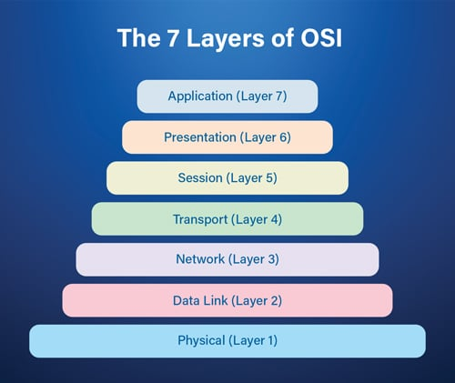
INTRODUCTION TO The SEVEN-LAYER OSI MODEL
conceptual framework that standardizes the functions of a communication system or network into seven distinct layers ;

Slide 17
Layer 7: Application
User interact with software applications directly (web browsers , email clients, video conf)
Layer 6 : Presentation
Takes care of data translation, encryption and compression.
Ensures data in usable format for the application layer.
Layer 5 : Session
Sets up, maintains, and ends communication sessions between devices.
Manages dialog control and synchronization to ensure proper data exchange.
Layer 4 : Transport
Data is divided into smaller chunks called segments or datagrams.
Ensures reliable and orderly delivery of these segments, managing control flow and error correction.
Layer 3 : Network
Handles routing, determining best path for data to travel between different networks.
Uses logical addresses (IPv4) to identify devices and ensure proper delivery.
Layer 2 : Data Link
Responsible for framing data into packets/frames and managing access to physical medium.
Ensures error-free transmission within the same network segment and uses MAC addresses for device identification.
Layer 1 : Physical
Physical transmission of data over physical medium, such as wires or wireless signals.
Defines specifications like voltage levels, cable types and signaling methods.

Slide 18
TCP/IP Protocol Suite
framework for communication between devices and systems across different networks
basis of modern networking and internet communication
Application Layer : interacts with end user application
Transport Layer : manages end to end communication, ensuring reliable data delivery and maintaining data integrity
Internet Layer : Handles the routing and addressing of data packets across networks. Core protocol is IP ; provides the addressing scheme used to identify devices on a network and enables routing of data between networks.
Link Layer : Deals with physical connection between devices on the same local network. Includes protocols related to hardware addressing (MAC addresses) and network media access control such as Ethernet and Wi-Fi protocols

Slide 19
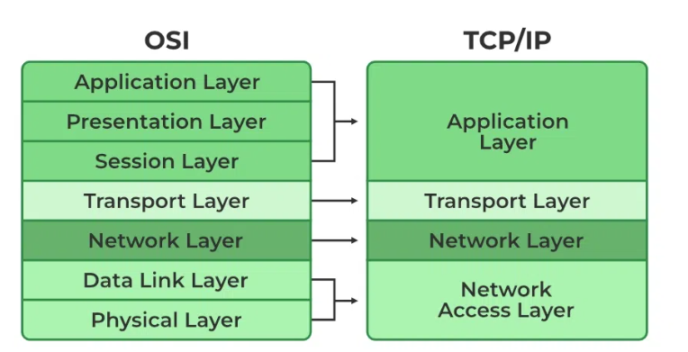

Slide 20
TRAFFIC CLASSIFICATIONS
Unicast
Broadcast
Multicast

Slide 21
UNICAST TRAFFIC
Example :
Sending an email from your computer to a specific recipient's email address.
Explanation :
Unicast traffic is one-to-one communication. In this case, your computer sends the email to a single, specific destination, which is the recipient's email address.

Slide 22
BROADCAST TRAFFIC
Example :
A computer sending a network discovery request (ARP - Address Resolution Protocol) to find the MAC address associated with an IP address on a local network.
Explanation :
Broadcast traffic is one-to-all communication within a local network segment. In this scenario, the requesting computer sends out a broadcast message, and all devices on the same network segment receive it. However, only the device with the matching IP address will respond.

Slide 23
MULTICAST TRAFFIC
Example :
An IT department sends software updates to all computers in a corporate network.
Explanation :
Multicast can be used to efficiently distribute software updates to all devices in the network that need the update. This reduces network congestion and speeds up the update process.

Slide 24
INTRODUCTION TO WIRESHARK
popular network analysis tool that helps you inspect and understand data flow
Packet Inspection
Network Troubleshooting
Protocol Analysis
Traffic Monitoring
Security Analysis
Learning Tool
User-Friendly Interface
Filtering
Open Source
Cross-Platform

Slide 25

INTRODUCTION TO WIRESHARK
https://www.wireshark.org/
Capturing packets
Saving and exporting capture files
Merging capture file – Three methods of merging
Packet Analysis
Finding packets (Display , Hex, String)
Marking Packets
Printing Packets
Time Display Formatting

Slide 26
COMMAND LINE PACKET ANALYSIS
Why command line?
wireshark provides a lot of information at once. using command line tool, we can limit displayed information to only pertinent data, such as single line showing IP addresses.
best suited for filtering a packet capture file and providing the results directly to another tool using Unix pipes
dealing with large file in Wireshark will overload the RAM. we can use stream processing of packets using command line tools.
used in servers where there is no GUI

Slide 27
INSTALLING TSHARK
Stored in same directory as Wireshark installation folder.
Capturing and saving packets
> tshark –h (help menu)
> tshark –D (list available interfaces)
> tshark –i 2 (specify interface)
> tshark –i 2 –w packets.pcap (write all packets captured in interface 2)

Slide 28

PACKET ANALYSIS IN DEPTH

Slide 29

NETWORK LAYER PROTOCOLS

Slide 30

ADDRESS RESOLUTION PROTOCOL

Slide 31
ADDRESS RESOLUTION PROTOCOL
Purpose: ARP helps devices find each other's physical (MAC) addresses when they know each other's IP addresses.
Scenario: Imagine two computers on the same network. They need to communicate. One knows the other's IP but not MAC. ARP helps find the MAC.
Process:
Computer A sends an ARP request: "Who has IP X.X.X.X?"
All devices on the network listen.
Computer B with IP X.X.X.X replies: "I have that IP. My MAC is YY:YY:YY:YY:YY:YY."
Computer A gets the MAC.
Result: Now A knows B's MAC, so they can send data directly.
Efficiency: ARP helps devices avoid broadcasting data to all devices on the network, making communication more efficient.

Slide 32
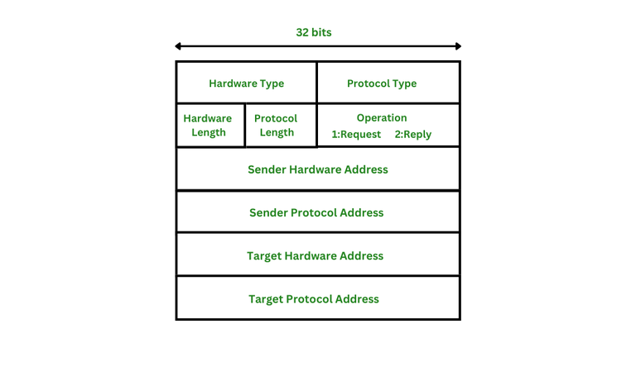

Slide 33

INTERNET PROTOCOL

Slide 34

INTERNET PROTOCOL
Fundamental communication protocol used for routing and addressing data packets across networks, including the Internet.
Routing: Guides data packets from sender to receiver across networks.
Addressing: Gives each device a unique IP address for identification.
Encapsulation: Wraps data for transmission, includes routing info.
Fragmentation: Splits large data into smaller packets for efficient travel.
Global Reach: Enables communication between devices worldwide.
Networking Layer: Works in the background, abstracts network complexities.
IPv4 & IPv6:Two versions; IPv6 for more addresses.
Routing Algorithms: Decides best paths for packet delivery.
QoS: Prioritizes traffic for better service.

Slide 35
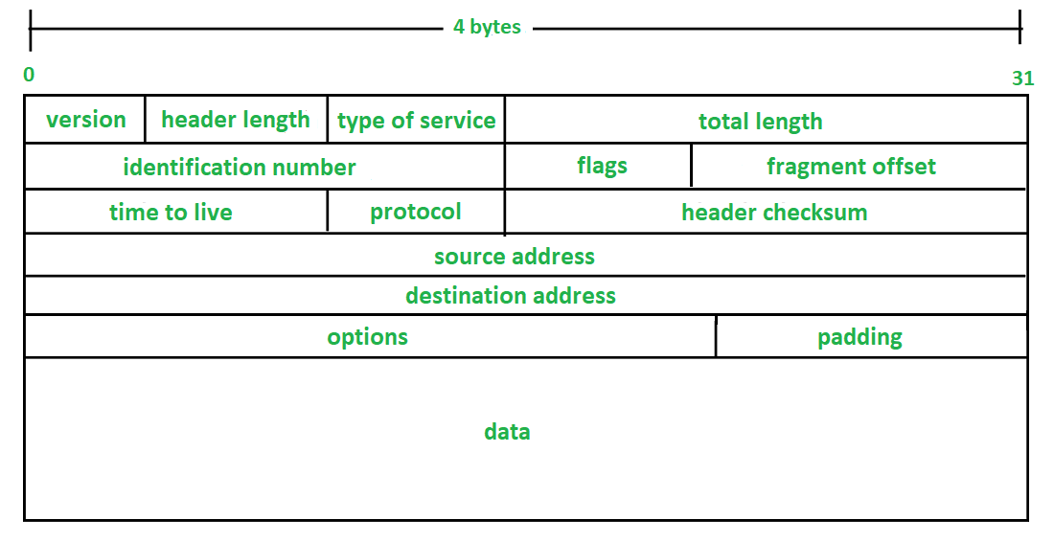

Slide 36
IPv4 vs IPv6
Address space :
IPv4 : 32 bits in length = 4.3 billion unique addresses
IPv8 : 128 bits in length = 340 undecillion (3.4 × 10^38) (340,000,000,000,000,000,000,000,000,000,000,000)
Address format :
IPv4 : 4 decimals = 192.168.1.1
IPv6 : 4 hexadecimals = 2001:0db8:85a3:0000:0000:8a2e:0370:7334
Addressing and Routing efficiency :
IPv4 : Limitations = Use of NAT
IPv6 : Remove the use of NAT
Header format :
IPv4 : variable in length and contains various fields for routing, fragmentation, and other information.
IPv6 : simpler and more efficient, with many optional features moved to extension headers.

Slide 37
ipv4 vs ipv6
Security and Authentication
IPv4 : Security feature like IPsec (Internet Protocol Security) are optional and added later.
IPv6 : IPsec support built into IPv6
Auto Configuration
IPv4 : DHCP (Dynamic Host Configuration Protocol) is commonly used for automatic IP address assignment.
IPv6 : includes built-in support for stateless auto-configuration, allowing devices to generate their own addresses without relying on a central DHCP server.

Slide 38

INTERNET CONTROL MESSAGE PROTOCOL

Slide 39
INTERNET CONTROL MESSAGE PROTOCOL
Used to send error messages and operational information about network conditions.
Common uses of ICMP :
Ping
Error reporting
Network diagnostic – RTT
Path MTU Discovery
Router Discovery

Slide 40
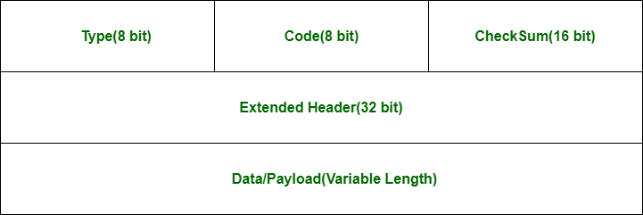

Slide 41

TRANSPORT LAYER PROTOCOLS

Slide 42

TRANSMISSION CONTROL PROTOCOL (TCP)

Slide 43
TRANSMISSION CONTROL PROTOCOL
Core of TCP/IP protocol suite for internet communication.
Ensures reliable data transmission.
Provides ordering of data packets.
Implements flow control to prevent congestion.
Connection-oriented with a three-way handshake.
Enables full-duplex communication.
Detects and corrects errors in data.
Essential for applications requiring dependable data exchange.
Used in web browsing, email, file transfers, etc.

Slide 44
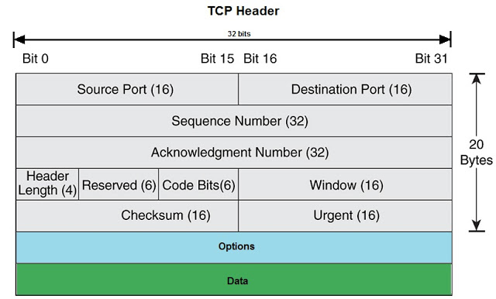

Slide 45

USER DATAGRAM PROTOCOL

Slide 46
USER DATAGRAM PROTOCOL
Connectionless
Unreliable
Low Overhead
No Ordering
No Flow Control
Suitable for Real-Time Applications
Broadcast and Multicast

Slide 47
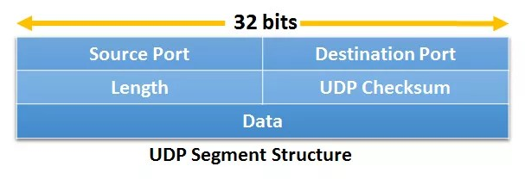
UDP Structure

Slide 48

COMMON UPPER LAYER PROTOCOLS

Slide 49

DYNAMIC HOST CONFIGURATION PROTOCOL

Slide 50
DYNAMIC HOST CONFIGURATION PROTOCOL
used to automatically assign IP addresses and other network configuration parameters to devices within a network.

Slide 51
DYNAMIC HOST CONFIGURATION PROTOCOL
Key points about DHCP:
IP Address Assignment
Automatic Configuration
Lease Duration
Centralized Control
Efficiency
Scalability
Broadcast and Unicast
DHCP Server
DHCP Client
DHCP Relay

Slide 52
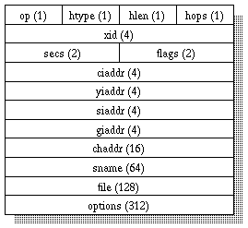
DHCP Packet structure

Slide 53

DOMAIN NAME SYSTEM (DNS)

Slide 54
DOMAIN NAME SYSTEM (DNS)
Hierarchical decentralized naming system used to translate human-friendly domain names (like www.example.com) into machine readable IP addresses (like 192.0.2.1).
enable users to access websites and services on the internet without having to remember numeric IP addresses.

Slide 55
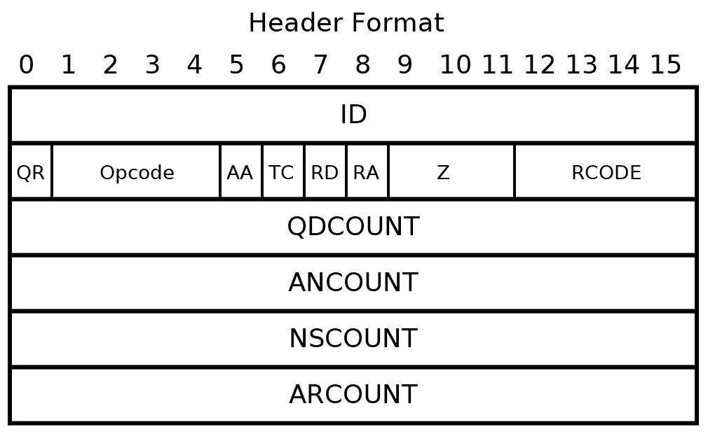
DNS PACKET STRUCTURE

Slide 56

HYPERTEXT TRANSFER PROTOCOL (HTTP)

Slide 57
HYPERTEXT TRANSFER PROTOCOL STRUCTURE
the delivery mechanism of the World Wide Web (WWW)
many different implementations of HTTP Protocol
different packet structure :
HTTP/1.0 and htTP/1.1
HTTP/2
Websocket
HTTP Methods (GET, OPTIONS, PUT, DELETE, POST, TRACE)
HTTP Headers (etc..)

Slide 58

SIMPLE MAIL TRANSFER PROTOCOL (SMTP)

Slide 59
SIMPLE MAIL PROTOCOL
standard protocol used for sending and transferring email messages between servers and clients.
structure can vary based on implementation and set of features supported by the client and the server
example

Slide 60
DaY 2
Real World Scenario Packet Analysis
Tapping Into The Wire
Packet Analysis for Security
Analyzing Attacks in the Network

Slide 61
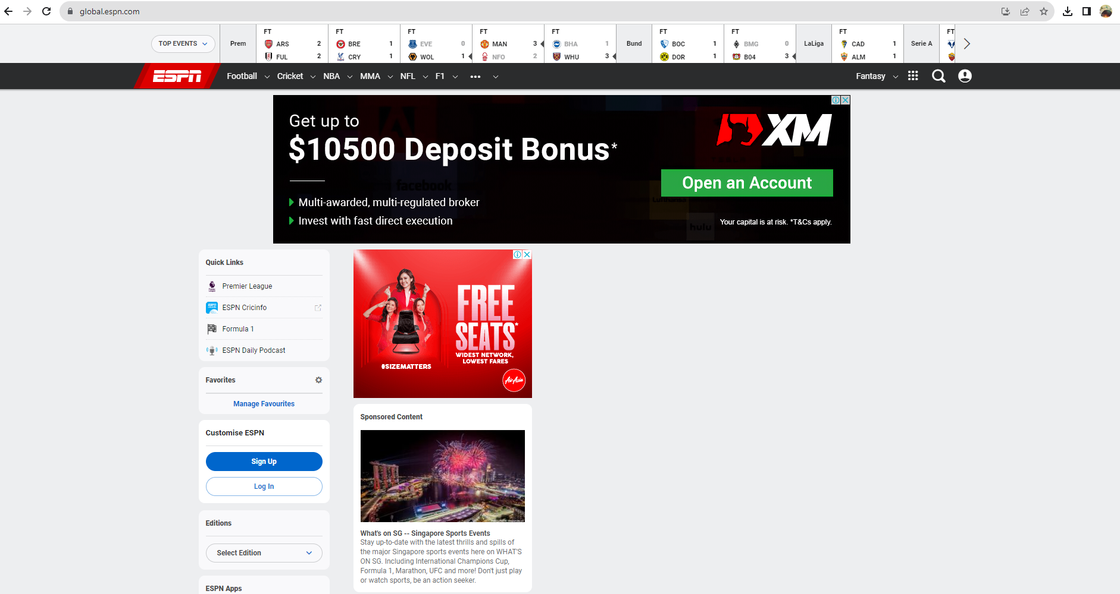
SCENARIO 1 : Missing web content

Slide 62
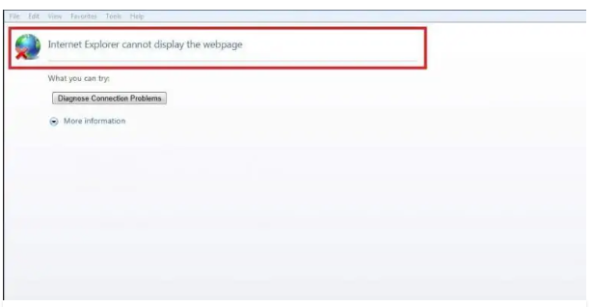
SCENARIO 2 : NO INTERNET ACCESS
a user cannot access their home page : https://google.com
when the user attempts to reach any domain hosted by google, they are redirected to a browser page “Internet Explorer cannot display the web page”
This issue is only affecting this particular user.
In a simple architecture – high likely not the network architecture issue.

Slide 63

SCENARIO 3 : NO INTERNET ACCESS, AGAIN
a user complain they have no internet access from their workstation, https://google.com
upon further investigation , this issue is affecting everyone in the organization – no one can access Google domains.
In a simple network architecture – high likely not architecture issue

Slide 64
SCENARIO 4 : Inconsistent PRINTER
IT help desk admin having trouble resolving a printing issue
users in sales department is reporting high-volume printer is malfunctioning
when a large print job is sent to the printer, it will print several pages and stop printing before the job is done
have tried installing and uninstalling the driver of printer, still unsuccessful
help desk staff want to check whether it’s a network problem or not

Slide 65
SCENARIO 5 : SOFTWARE DATA CORRUPTION
Problem statement :
a programmer has developed an application for tracking sales at multiple stores back to central database
to save bandwith during normal business hours, the application does not update in real time
data is accumulated throughout the day and transmitted at night as CSV file to be inserted to the database via FTP
Issues :
the app does not function properly
files sent to database, but the data inserted is not correct
sections are missing, data in wrong place and some portions are missing
the programmer blames the network for the issue
they are convinced that the filed are corrupted while in transit from the stores to the central data repository
our goal is to determine whether they are correct, and the network is to blame?

Slide 66
WHAT IS TCP RETRANSMISSION?

Slide 67
TCP RETRansmission
sender does not receive an acknowledgement (ACK) from the receiver within a certain timeframe.
to ensure reliable data delivery
if sender does not receive an ACK for the transmitted packet, it assumes that the packet was lost or corrupted
initiates a retransmission

Slide 68
TCP RETRANSMISSION
Packet lost
Congestion
Bit Errors
Out-of-Order Delivery
Delayed ACKs

Slide 69

PACKET ANALYSIS FOR SECURITY

Slide 70

RECONNAISSANCE

Slide 71
RECONNAISSANCE
Initial phase of cyber attack.
Gathering information about target.
Identifying vulnerabilities and weaknesses.
Types: Passive (non-intrusive) and Active (intrusive).
Methods: Open-source intelligence, network scanning, social engineering.
Goal: Identify potential entry points and plan attack strategies.
Key for proactive defense and vulnerability mitigation.

Slide 72

SYN SCAN

Slide 73
What is a SYN SCAN?
is also known as stealth scan or a half open scan.
most common type ;
fast and reliable
accurate on all platforms, regardless of TCP stack implementation
less noisy than other scanning techniques

Slide 74
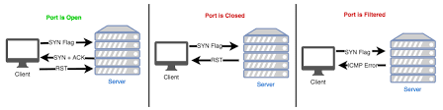
TCP SYN SCAN

Slide 75

ARP CACHE POISONING

Slide 76
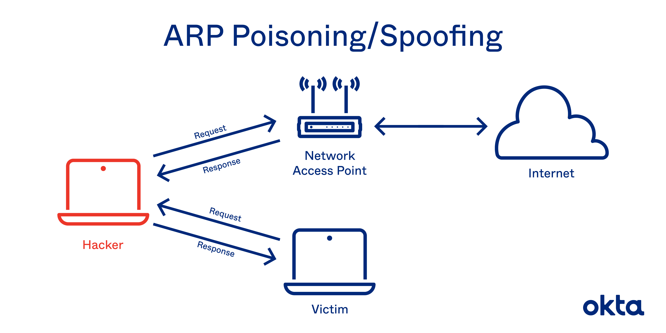
ARP CACHE POISONING

Slide 77

SESSION HIJACKING

Slide 78
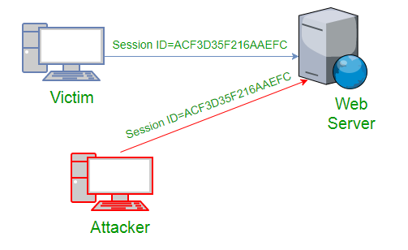
SESSION HIJACKING IN ACTION

Slide 79

WIRELESS PACKET ANALYSIS

Slide 80
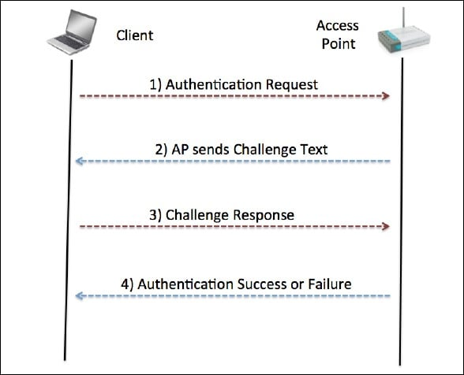
WIRELESS SECURITY WEP Authentication

Slide 81
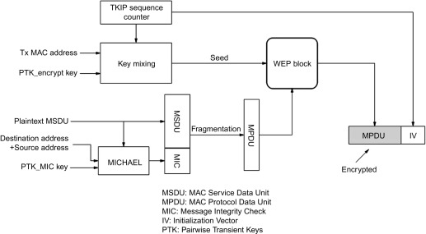
WIRELESS SECURITY - WPA AUTHENTICATION

Slide 82
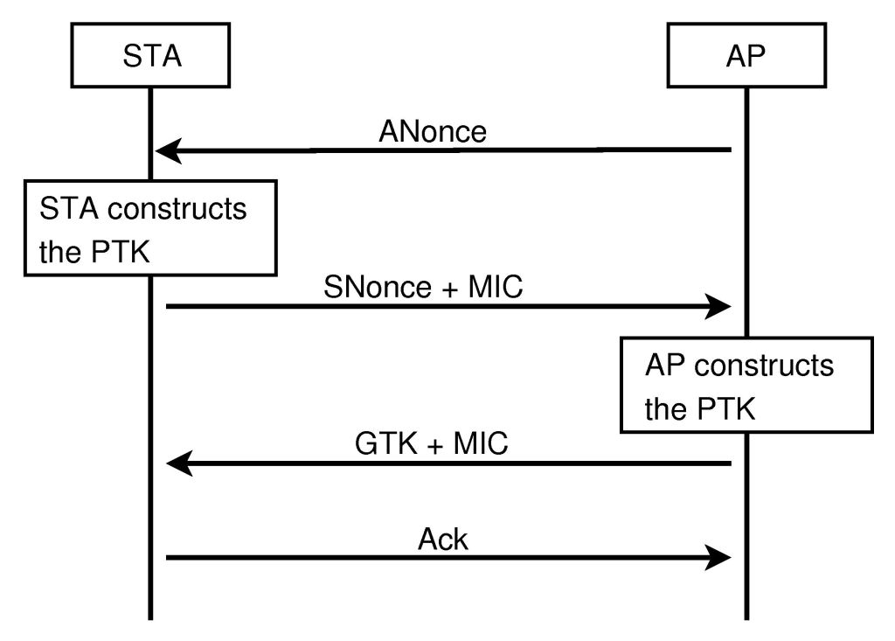

Slide 83

END

